Slide 1

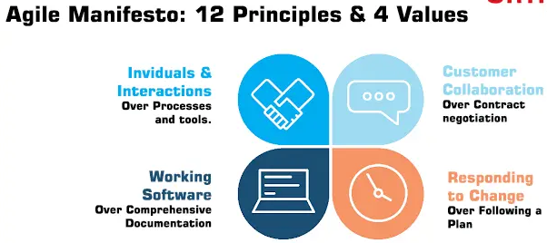
Agile Software Development
Topic: Agile Manifesto
Dr. Nikhil Govil
Associate Professor, Program Coordinator – B.Tech. (CSE), Dept. of CEA

Slide 2

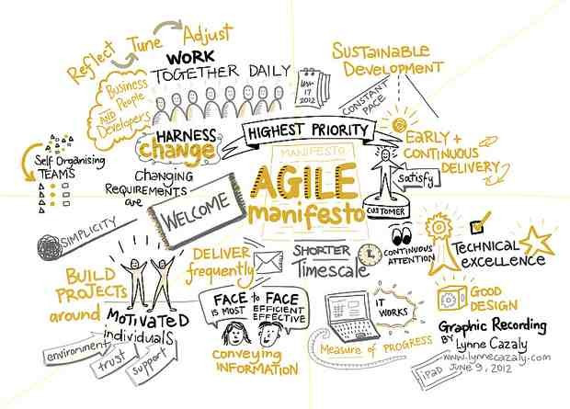
Agile Manifesto

Slide 3
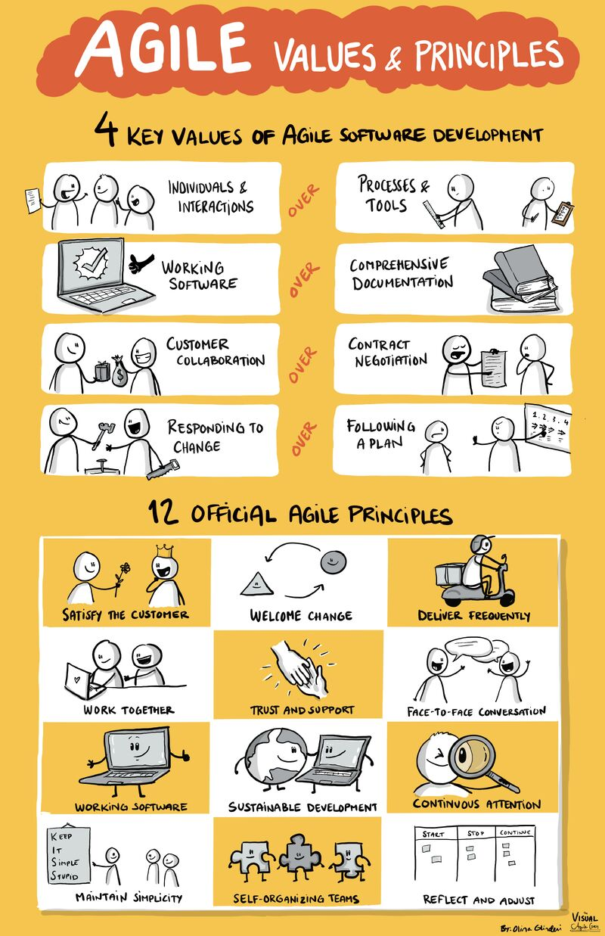
Agile Manifesto

Slide 4
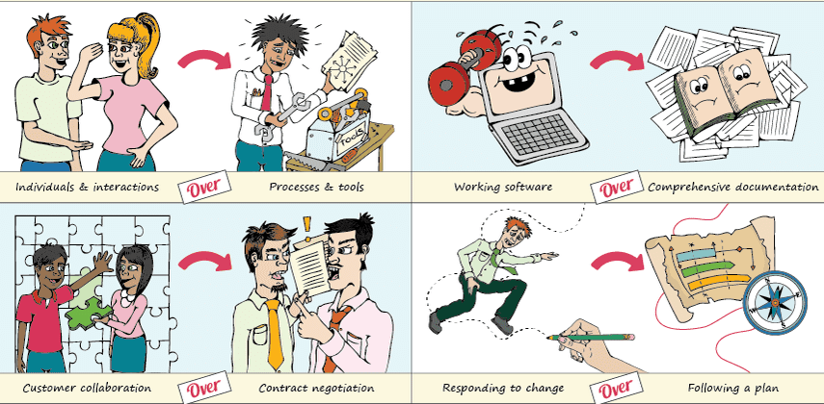
The Four Values of Agile Manifesto

Slide 5
The Four Values of Agile Manifesto
1. Individual and Interactions Over Processes and Tools
This value of the Agile manifesto focuses on giving importance to communication with the clients.
There are several things a client may want to ask and it is the responsibility of the team members to ensure that all questions and suggestions of the clients are promptly dealt with.

Slide 6
The Four Values of Agile Manifesto
2. Working Software Over Comprehensive Documentation
In the past, more focus used to be on proper documentation of every aspect of the project.
The Agile values dictate that the first and foremost duty of the project team is completing the final deliverables as identified by the customers.

Slide 7
The Four Values of Agile Manifesto
3. Customer Collaboration Over Contract Negotiation
Agile principles require customers to be involved in all phases of the project.
The Waterfall approach or Traditional methodologies only allow customers to negotiate before and after the project.
If the customers are kept in the loop during the development process, team members can ensure that the final product meets all the requirements of the client.

Slide 8
The Four Values of Agile Manifesto
4. Responding to Change Over Following a Plan
Circumstances change and sometimes customers demand extra features in the final product that may change the project scope.
In these cases, project managers and their teams must adapt quickly in order to deliver a quality product and ensure 100% customer satisfaction.

Slide 9
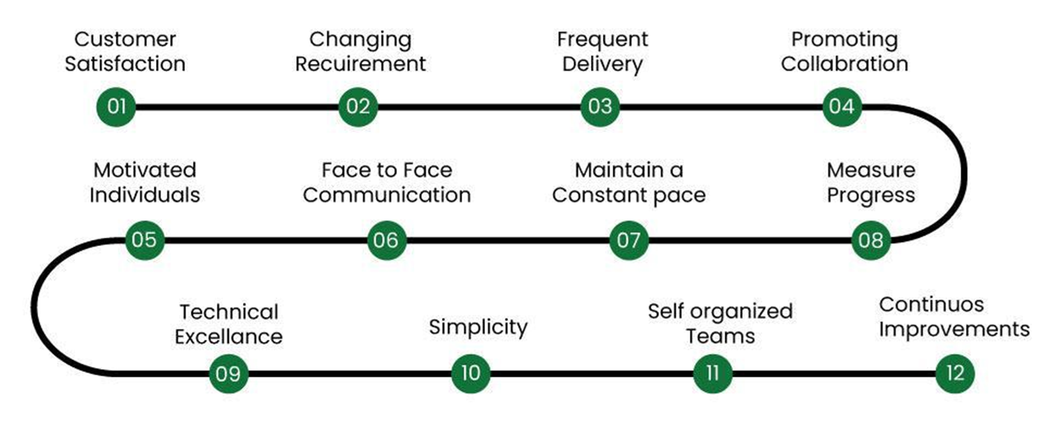
The Twelve Agile Principles

Slide 10
The Twelve Agile Principles
1. Customer Satisfaction is the highest priority
Our highest priority is to satisfy the customer through early and continuous delivery of valuable software.
2. Welcome changing requirements, even late in development
Welcome changing requirements, even late in development. Agile processes harness change for the customer’s competitive advantage.
3. Deliver working software frequently
Deliver working software frequently, from a couple of weeks to a couple of months, with a preference to the shorter timescale.

Slide 11
The Twelve Agile Principles
4. Promoting Collaboration
Business people and developers must work together daily throughout the project.
5. Build projects around motivated individuals
Build projects around motivated individuals. Give them the environment & support they need, and trust them to get the job done.
6. Face-to-face conversations for conveying information
The most efficient and effective method of conveying information to and within a development team is face-to-face conversation.

Slide 12
The Twelve Agile Principles
7. Tracking outputs instead of done tasks
Working software is the primary measure of progress.
8. Agile processes promote sustainable development
Agile processes promote sustainable development. The sponsors, developers, and users should be able to maintain a constant pace indefinitely.
9. Technical excellence and good design
Continuous attention to technical excellence and good design enhances agility.

Slide 13
The Twelve Agile Principles
10. Simplicity is essential
Writing simple code without unnecessary complexity is essential.
11. Self-organized teams
The best architectures, requirements, and designs emerge from self-organizing teams.
12. Continuous Improvement
At regular intervals, the team reflects on how to become more effective, then tunes and adjusts its behavior accordingly.

Slide 14
Reference Books
Ken Schawber & Mike Beedle, Agile Software Development with Scrum, Pearson, 2008.
Robert C. Martin, Agile Software Development, Principles, Patterns and Practices, Prentice Hall, 2002.
Lisa Crispin & Janet Gregory, Agile Testing: A Practical Guide for Testers and Agile Teams, Addison Wesley, 2008.
Alistair Cockburn, Agile Software Development: The Cooperative Game, Addison Wesley, 2006.

Slide 15


